Slide 1


Slide 2
Outline
Motivation
Literature Review
Methods
Analysis Method
Contribution

Slide 3
Motivation
Analyzing data on social networks: Twitter, Facebook, YouTube
Example: sentiment analysis
Event Detection: automatically identifying significant incidents

Slide 4
Challenge
Common Difficulties:
(1) short and noisy information
(2) rapidly changing topics
(3) great volume data
Difficulty in Chinese: more complex grammar, polysemy

Slide 5
Literature Review
Word Embedding: words are mapped into vectors of real numbers
Deep learning: CNN(Convolutional Neural Networks)
RNN(Recurrent Neural Networks)
Shortcomings: not semantic features

Slide 6
Research Question
Can a word embedding technique combined with different semantic features be used to improve the F1-measure value of Automatic Context Extraction (ACE) Chinese event detection task using Bidirectional Long Short-Term Memory (Bi-LSTM) network in social media?

Slide 7
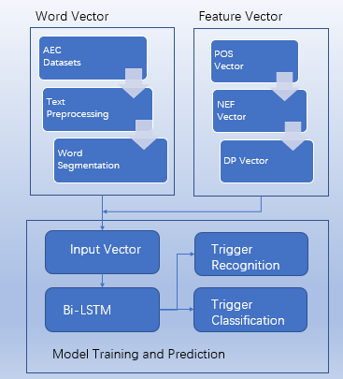
Methods
word embedding,
feature representation
Bidirectional Long Short-Term
Memory (Bi-LSTM) network

Slide 8
Word Embedding
One-hot representation
Distributed representation:
Smaller dimension
Similarity between words
Word2vec

Slide 9
Feature Vector
part-of-speech (POS) vector
Named Entity Feature (NEF) vector
dependency parsing (DP)

Slide 10
Part-of-Speech (POS) Vector
word type (such as verb, noun, adjective or other types)
25 dimensions

Slide 11
Named Entity Feature (NEF) vector
Special meaning for words
13 dimensions

Slide 12
Dependency parsing (DP)
dependency relationship between the center word and dependent word
14 dimensions

Slide 13
Model
Bidirectional Long Short-Term
Memory network (Bi-LSTM)

Slide 14
Analysis Method
experiment datasets: ACE (Automatic Context Extraction)
Evaluation criteria: Precision, Recall, F1-measure

Slide 15
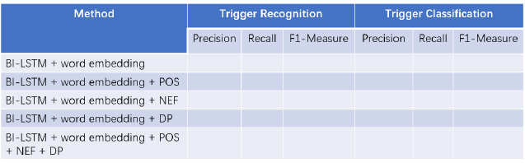
Analysis Method
Sample table

Slide 16
Contribution
Combine more semantic information into word vector
Better combination of feature representation

Slide 17

Thank you for your listening

